Slide 1

Anomalies detection in crop health and creating a custom flight path.
CB.EN.U4AEE21034
Erukala Sashank
Case Study Review-3.2
Git hub URL: https://github.com/123sashank321/Anamolies_Detection_in_Crops
Sites.google : https://sites.google.com/view/anamolies-detection-in-crops/home
Professor : Dr. T Senthil Kumar(CSE)
Collaborator : Mr. Adarsh (Sky –X)
Professor : S Thangeswari

Slide 2
Contents
Problem Statement
Block Diagram
Architecture Diagram
Algorithm Explanation
Dataset Description
Hyper Parameters
Performance Metrics
Comparison of Architectures
Poster
Explainable AI

Slide 3
Problem Statement
Current methods for monitoring crop health and managing agricultural spraying are often inefficient and labor-intensive, leading to suboptimal crop yields and increased pesticide use. There is a need for an advanced system that combines machine learning and drone technology to detect anomalies in crop health early and automate the creation of precise, customized flight paths for treatment. This will address issues of inefficiency, high operational costs, and environmental impact in modern agriculture.

Slide 4
Literature Survey
Mendoza-Bernal, J., González-Vidal, A., & Skarmeta, A. F. (2024). A Convolutional Neural Network approach for image-based anomaly detection in smart agriculture. Expert Systems With Applications, 247, 123210. https://doi.org/10.1016/j.eswa.2024.123210
Xu, W., Xu, T., Thomasson, J. A., Chen, W., Karthikeyan, R., Tian, G., Shi, Y., Ji, C., & Su, Q. (2023). A lightweight SSV2-YOLO based model for detection of sugarcane aphids in unstructured natural environments. Computers and Electronics in Agriculture, 211, 107961. https://doi.org/10.1016/j.compag.2023.107961
Singh, E., Pratap, A., Mehta, U., & Azid, S. I. (2024). Smart Agriculture Drone for Crop Spraying Using Image-Processing and Machine Learning Techniques: Experimental Validation. IoT, 5(2), 250–270. https://doi.org/10.3390/iot5020013
Attri, I., Awasthi, L. K., Sharma, T. P., & Rathee, P. (2023). A review of deep learning techniques used in agriculture. Ecological Informatics, 77, 102217. https://doi.org/10.1016/j.ecoinf.2023.102217
Aldakheel, E. A., Zakariah, M., & Alabdalall, A. H. (2024). Detection and identification of plant leaf diseases using YOLOv4. Frontiers in Plant Science, 15. https://doi.org/10.3389/fpls.2024.1355941
Ariwa, R. N., Markus, C., Teneke, N. G., Adamu, S., & Fumlack, K. G. (2024). Plant Disease Detection Using Yolo Machine Learning Approach. British Journal of Computer Networking and Information Technology, 7(2), 115–129. https://doi.org/10.52589/bjcnit-ejwgfw6d
Narmilan, A., Gonzalez, F., Salgadoe, A., & Powell, K. (2022). Detection of White Leaf Disease in Sugarcane Using Machine Learning Techniques over UAV Multispectral Images. Drones, 6(9), 230. https://doi.org/10.3390/drones6090230

Slide 5
Literature Survey
Title | Methodology | Purpose | Result
A Convolutional Neural Network approach for image-based anomaly detection in smart agriculture | Convolutional neural networks (CNN) for identifying anomalies in agricultural images. | It aims to address issues like class imbalance, lack of model generalization, and insufficient variety of training images by leveraging data augmentation techniques and Gaussian noise addition. | The methodology improved accuracy for both the Deep Weeds dataset (98%) and the Agriculture-Vision dataset (95.3%) using CNNs.
A lightweight SSV2-YOLO based model for detection of sugarcane aphids in unstructured natural environments | a lightweight SSV2-YOLO model based on YOLOv5s for SCA detection by reconstructing the backbone network with Stem and ShuffleNet V2 and adjusting the neck network width. | Existing pest detection algorithms struggle with small, high-density pests in natural environments due to computational constraints and image challenges. This calls for more efficient and accurate methods. | Compared with the YOLOv5s, SSV2-YOLO significantly reduced model complexity , parameter number (by 95.1%), model size (by 92.5%), increased detection speed (GPU by 31.6% and CPU by 81.8%) and improved accuracy (by 2.5%).
Smart Agriculture Drone for Crop Spraying Using Image-Processing and Machine Learning Techniques: Experimental Validation | a smart agriculture drone integrated with Internet of Things technologies that use machine learning techniques such as TensorFlow Lite with an EfficientDetLite1 model | To identify objects from a custom dataset trained on three crop classes, namely, pineapple, papaya, and cabbage species, achieving an inference time of 91 ms. | As a result, the drone maintained a speed of 7.5 m/s, synchronized with an image-processing time of 91 ms. This alignment allowed for effective image capture and processing, ensuring precise and timely spraying.

Slide 6
Literature Survey
Title | Methodology | Purpose | Result
Detection of White Leaf Disease in Sugarcane Using Machine Learning Techniques over UAV Multispectral Images | To develop a method for early detection of White Leaf Disease (WLD) in sugarcane using UAV multispectral imagery and machine learning, aiming for precision agriculture. | Utilized UAV multispectral imagery with machine learning classifiers (XGBoost, Random Forest, Decision Tree, KNN) on sugarcane crops, assessing vegetation indices and spectral bands to distinguish disease levels. | Achieved 94% accuracy for WLD detection using XGBoost, Random Forest, and KNN, with top features being specific vegetation indices (e.g., MSAVI, NDVI) and spectral bands (red, green).
A Review of Deep Learning Techniques Used in Agriculture | The review used extensive keyword searches in Web databases, focusing on papers that discuss deep learning in various agricultural applications | To review recent deep learning applications in agriculture, categorize them, highlight critical research gaps, and discuss potential improvements in model accuracy, efficiency, and usability​ | Deep learning applications, including CNN,RNNs,YOLO were found effective for tasks like crop yield prediction, pest and weed detection, and disease detection.
Detection and identification of plant leaf diseases using YOLOv4 | Utilized YOLOv4 for plant disease detection with Plant Village Dataset; used data augmentation and comparisons with models like Densenet and Alexanet​ | To enhance the precision and efficiency of plant disease identification, aiding farmers in early detection and management​ | Achieved a high accuracy of 99.99% on the Plant Village dataset, highlighting YOLOv4’s effectiveness for plant disease detection​

Slide 7
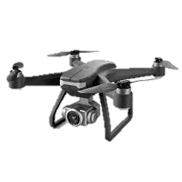
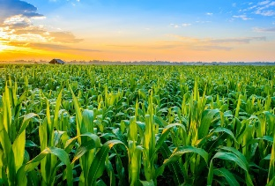
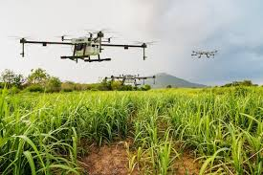
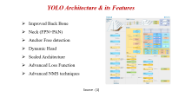
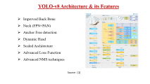
Block Diagram
Global Coordinates of Anomaly
Deep Learning Model
Reach the Coordinates
Send Coordinates to Drone Flight controller
Path Planning algorithms to reach those coordinates

Slide 8
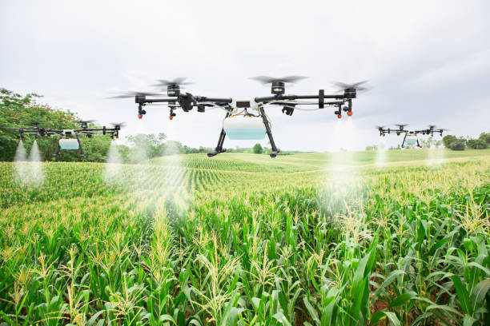
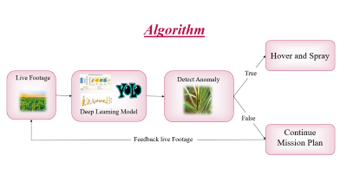
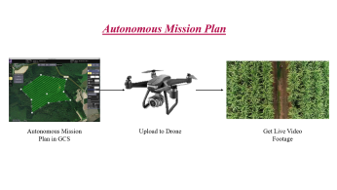
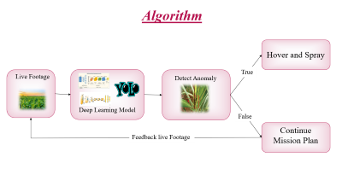
Architecture Diagram
Autonomous Mission Plan
Output
AI and Algorithm

Slide 9
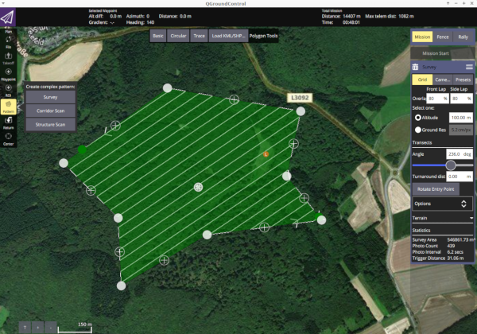
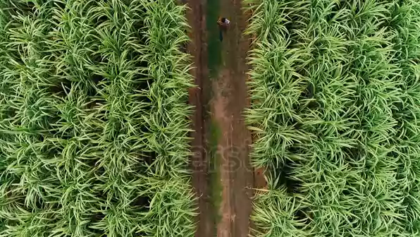
Autonomous Mission Plan
Autonomous Mission Plan in GCS
Upload to Drone
Get Live Video Footage

Slide 10
Algorithm Explanation
1. Initialize PixhawkSprayController:
- Connect to Pixhawk flight controller.
- Set spray state to 'inactive'.
- Create a queue for spray commands.
2. Initialize DiseaseDetector:
- Load the YOLO model for disease detection.
- Set confidence threshold for detections.
3. Start a background thread to handle spray commands:
- While True:
- If spray command queue is not empty and spray is inactive:
- Set spray state to 'active'.
- Get disease detection data from queue.
- Activate spray system.
- Wait 5 seconds.
- Deactivate spray system.
- Set spray state to 'inactive'.
- Wait briefly to avoid CPU overload.

Slide 11
Algorithm Explanation
4.Main video processing loop:
- Initialize video capture.
- While video is running:
- Capture a video frame.
- Process frame using DiseaseDetector:
- Detect diseases based on confidence threshold.
- For each detection:
- Draw bounding box and label on the frame.
- If spray is not active:
- Add detection to spray command queue.
- Display the video frame with detections.
- If 'q' key is pressed, break the loop.
5. Cleanup:
- Release video capture.
- Close any open display windows.

Slide 12
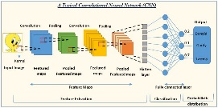

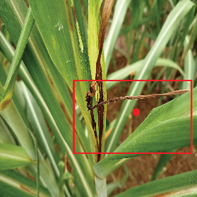
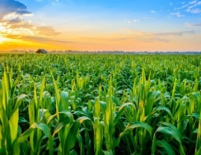
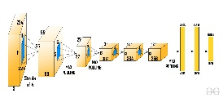
Algorithm
Hover and Spray
True
Live Footage
Detect Anomaly
Deep Learning Model
False
Continue Mission Plan
Feedback live Footage

Slide 13
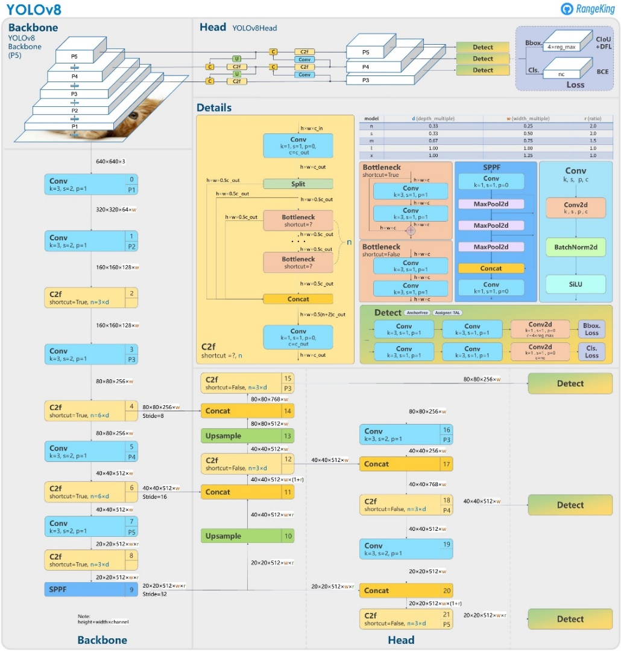
YOLO-v8 Architecture & its Features
Improved Back Bone
Neck (FPN+PAN)
Anchor Free detection
Dynamic Head
Scaled Architecture
Advanced Loss Function
Advanced NMS techniques
Source : [1]

Slide 14

YOLO Architecture & its Features
Source : [1]

Slide 15
YOLO Architecture & its Features
Source : [1]

Slide 16
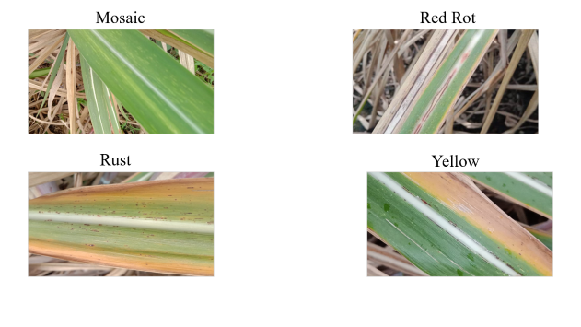
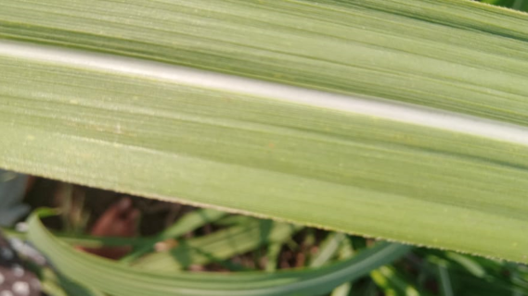
Dataset Description
Dataset for our project is mainly based on sugarcane crops.
Our Dataset consists of images categorized into folders of
Healthy
Unhealthy

Slide 17
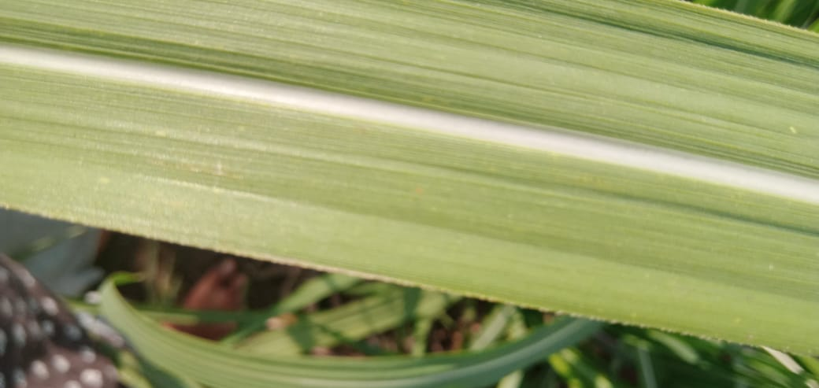

Slide 18
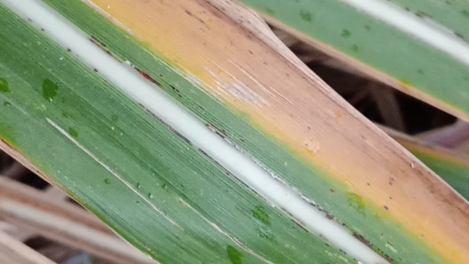
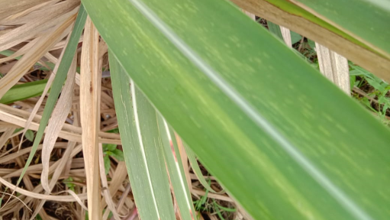
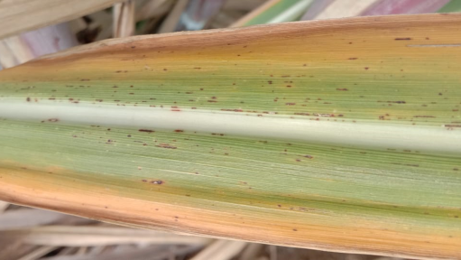
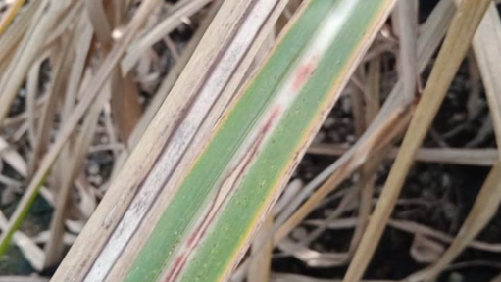
Mosaic
Red Rot
Rust
Yellow

Slide 19
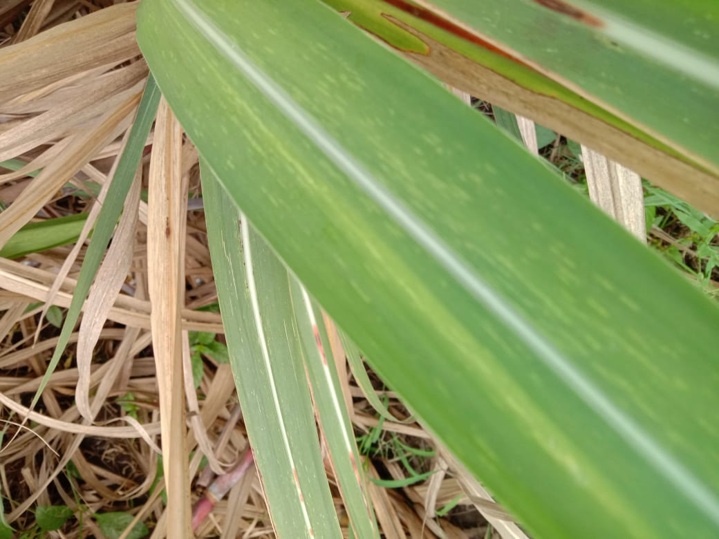

Slide 20
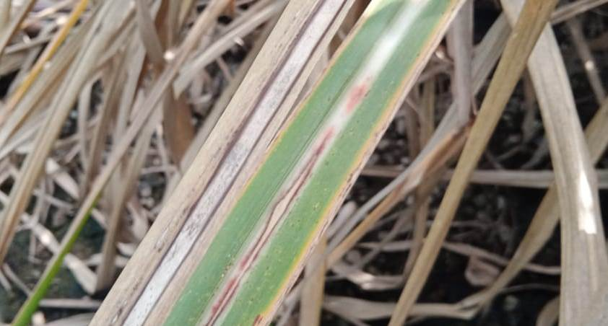

Slide 21
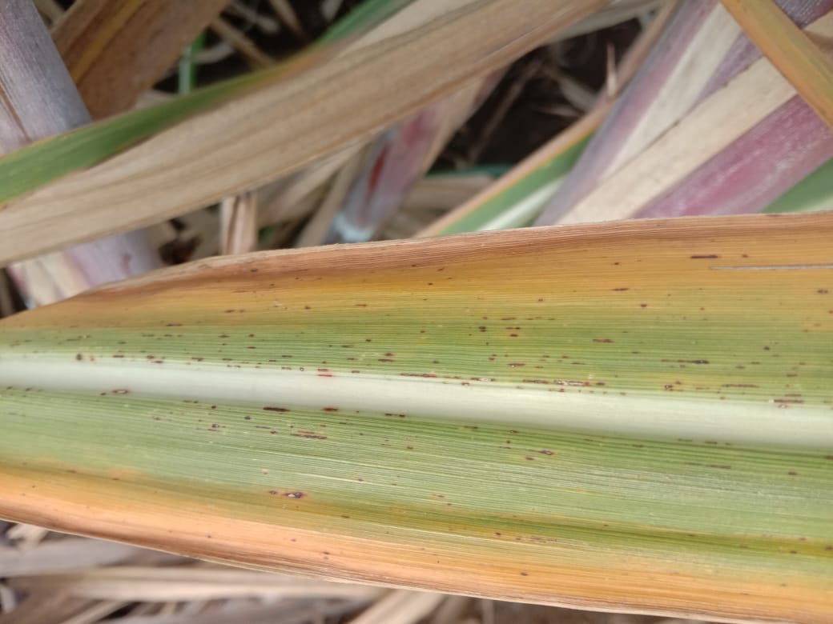

Slide 22
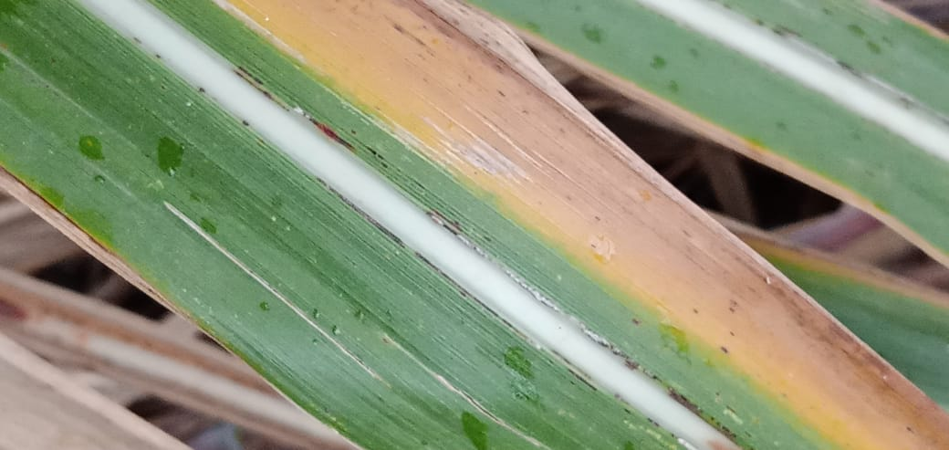

Slide 23
Hyper Parameter Table
Hyperparameter | Description | Typical Range
Learning Rate | Controls the step size during optimization | 1e-5 to 1e-2
Batch Size | Number of training examples used in one iteration | 16
Number of Epochs | Number of complete passes through the training dataset | 50
Image Size | Input image dimensions | 640
Optimizer | Algorithm to update network weights | Adam, SGD
Momentum (for SGD) | Accelerates gradient descent | 0.9 to 0.99
Augmentation Strength | Intensity of data augmentation | 0 to 1
Warmup Epochs | Number of epochs for learning rate warmup | 0 to 5
Box Loss Weight | Weight for bounding box regression loss | 0.02 to 0.1
Class Loss Weight | Weight for classification loss | 0.2 to 1.0

Slide 24
Hyper Parameter Setup
Hyperparameter | Default Value | Description
lr0 | 0.01 | Initial learning rate
lrf | 0.01 | Final learning rate factor
momentum | 0.937 | SGD momentum/Adam beta1
weight_decay | 0.0005 | Optimizer weight decay
warmup_epochs | 3.0 | Warmup epochs (fractions ok)
warmup_momentum | 0.8 | Warmup initial momentum
warmup_bias_lr | 0.1 | Warmup initial bias learning rate
box | 7.5 | Box loss gain
cls | 0.5 | Classification loss gain
dfl | 1.5 | DFL loss gain

Slide 25
Training Setup
Setting | Default Value | Description
epochs | 100 | Number of training epochs
batch_size | 16 | Number of images per batch
imgsz | 640 | Input image size
optimizer | 'auto' | Optimizer to use (SGD, Adam, Adamax, etc.)
seed | 0 | Random seed for reproducibility
deterministic | True | Whether to enable deterministic mode
single_cls | False | Train multi-class data as single-class
rect | False | Rectangular training with each batch collated
amp | True | Automatic Mixed Precision training
fraction | 1.0 | Dataset fraction to train on

Slide 26
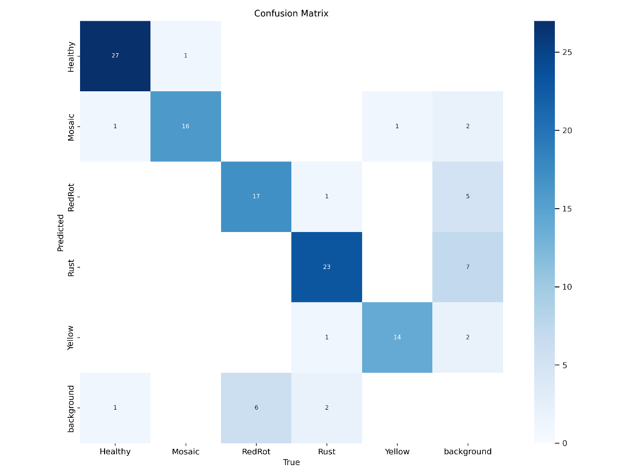
Performance Metrics
Confusion Matrix :This shows the relationship between predicted (y-axis) and true (x-axis) labels
Healthy class: 27 correct predictions with only 1 false positive and 1 false negative
Mosaic: 16 correct predictions with minimal confusion
RedRot: 17 correct predictions but 6 instances confused with background
Rust: 23 correct predictions with some background confusion (7 cases)
Yellow: 14 correct predictions with minimal confusion
Strong diagonal values indicate good model learning
Background confusion suggests some detection threshold issues
Disease classes have minimal inter-class confusion, showing good feature discrimination

Slide 27
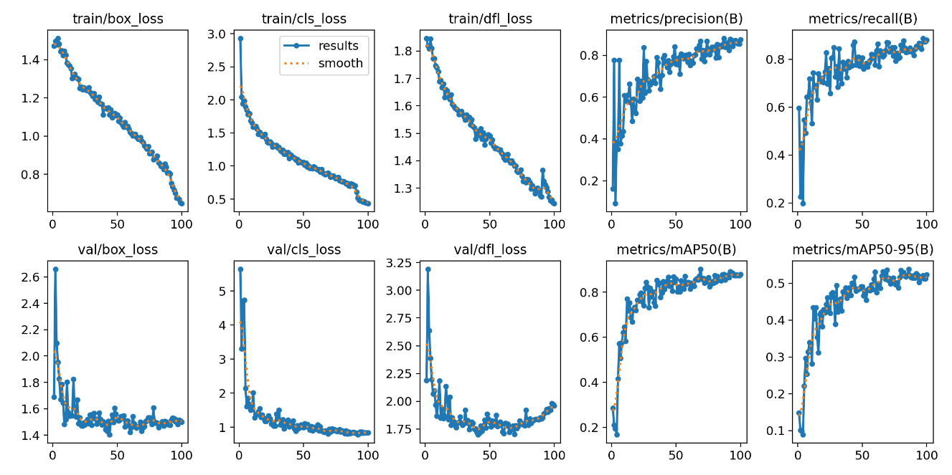
Performance Metrics
Box Loss: The train/box_loss and val/box_loss curves show a gradual decrease over the epochs, indicating that the model is learning to accurately localize the bounding boxes for objects in both the training and validation sets. The validation loss stabilizes, showing a good fit.
Classification Loss: The train/cls_loss and val/cls_loss curves also decrease over time, suggesting that the model is learning to classify objects effectively. The validation classification loss stabilizes around epoch 20, indicating a stable learning process.
DFL (Distribution Focal Loss): The train/dfl_loss and val/dfl_loss curves also show a similar decreasing trend, reflecting improved precision in bounding box predictions.

Slide 28
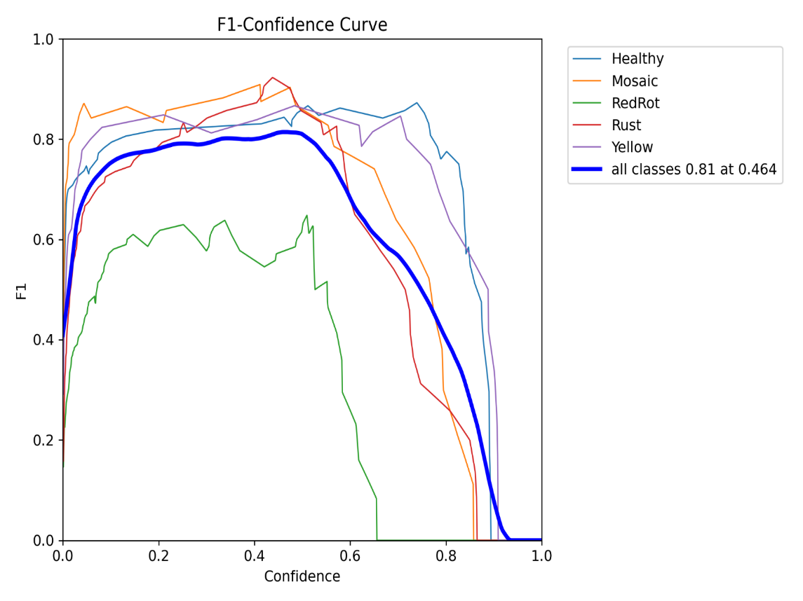
Performance Metrics
F1-Confidence Curve (Image 2):
Shows F1-score vs confidence threshold for each class
Key observations:
Peak F1 score of 0.87 at confidence threshold 0.390
Healthy and Yellow classes maintain high F1 scores across confidence levels
RedRot shows earlier performance degradation
Curves peak around 0.4 confidence, suggesting optimal detection threshold
Different slopes indicate varying robustness of detection across classes
Steeper drops after 0.6 suggest overconfidence issues at higher thresholds

Slide 29
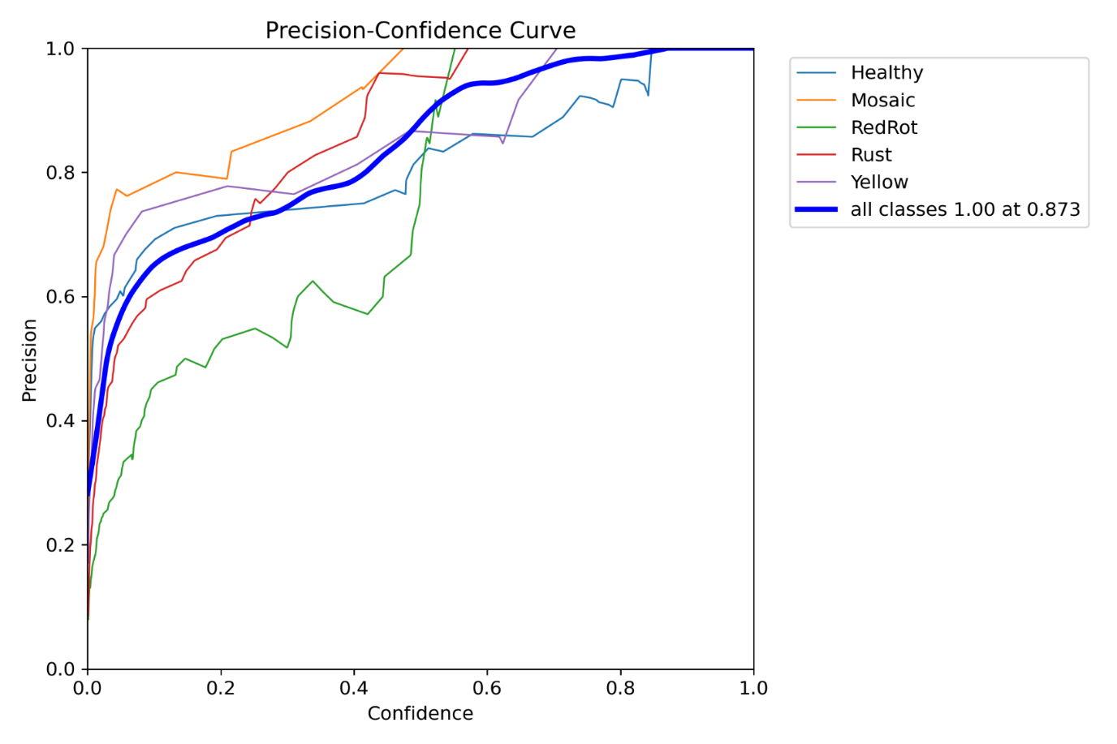
Performance Metrics
Precision-Recall Curve (Image 3):
Shows trade-off between precision and recall
Key metrics:
Healthy: 0.955
Yellow: 0.957
Mosaic: 0.945
Rust: 0.855
RedRot: 0.790
High curves (Healthy, Yellow) indicate consistent reliable detection
Lower curves (RedRot) suggest more false positives/negatives
Overall mAP@0.5 of 0.901 shows strong general performance

Slide 30
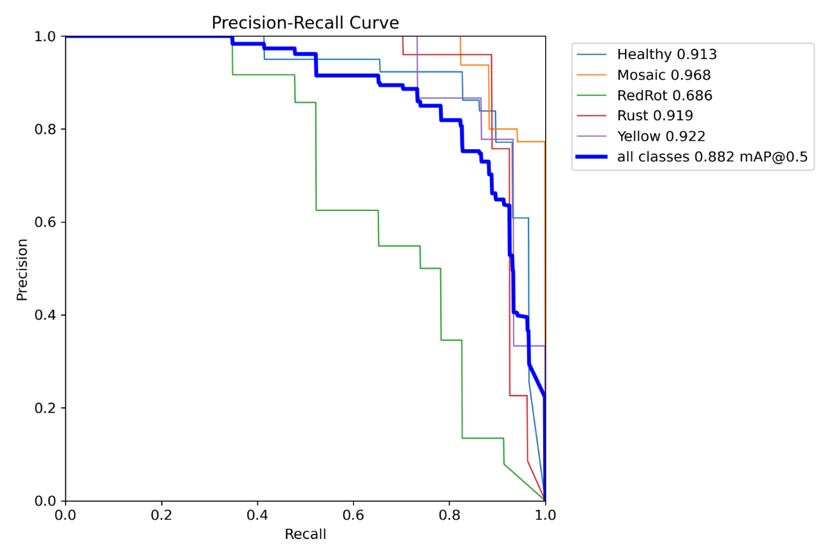
Performance Metrics
Recall-Confidence Curve (Image 4):
Shows how recall varies with confidence threshold
Key observations:
High initial recall (0.95 at 0.0 confidence)
Gradual decline as confidence increases
Different decline rates across classes
Healthy and Yellow maintain high recall longer
RedRot and Rust show earlier recall drop
Suggests need for class-specific confidence thresholds

Slide 31
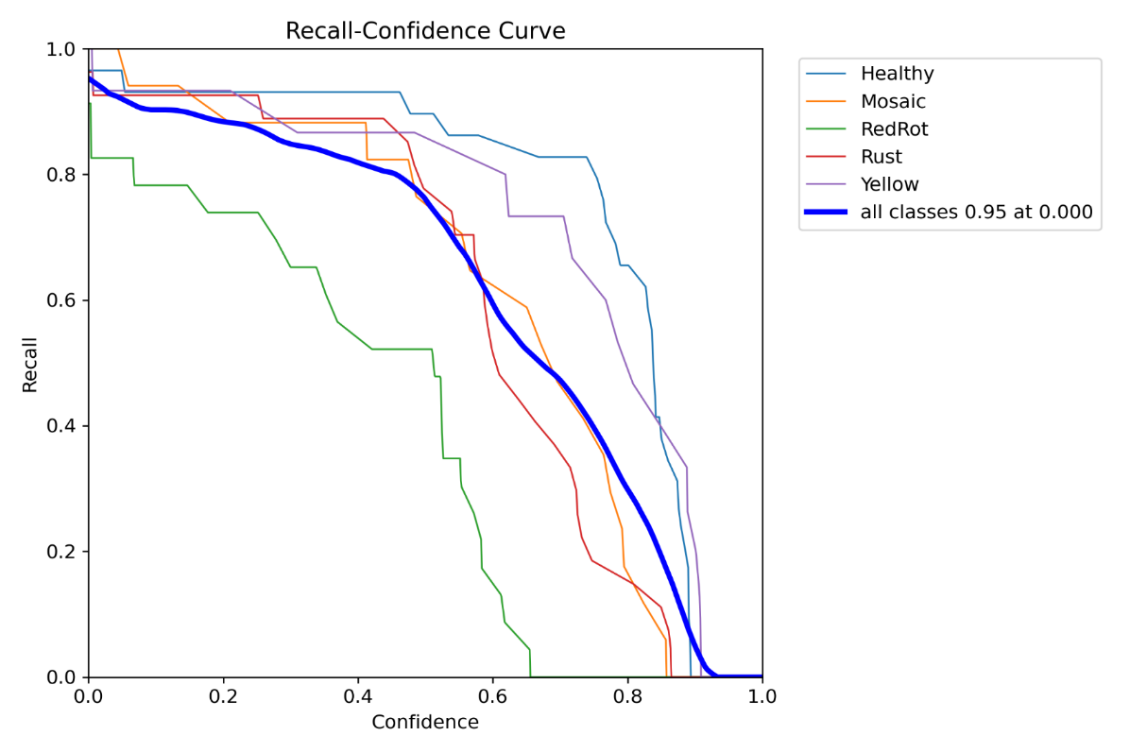
Performance Metrics
Precision-Confidence Curve (Image 5):
Shows precision vs confidence threshold
Key observations:
All classes reach 1.0 precision at high confidence
Different rates of precision increase
Overall curve reaches 1.00 at 0.822 confidence
Steady increase shows good confidence calibration
High final precision indicates reliable high-confidence predictions
Some classes (like RedRot) show more variability in precision

Slide 32
Performance Metrics
Precision-Confidence Curve (Image 5):
Shows precision vs confidence threshold
Key observations:
All classes reach 1.0 precision at high confidence
Different rates of precision increase
Overall curve reaches 1.00 at 0.822 confidence
Steady increase shows good confidence calibration
High final precision indicates reliable high-confidence predictions
Some classes (like RedRot) show more variability in precision

Slide 33
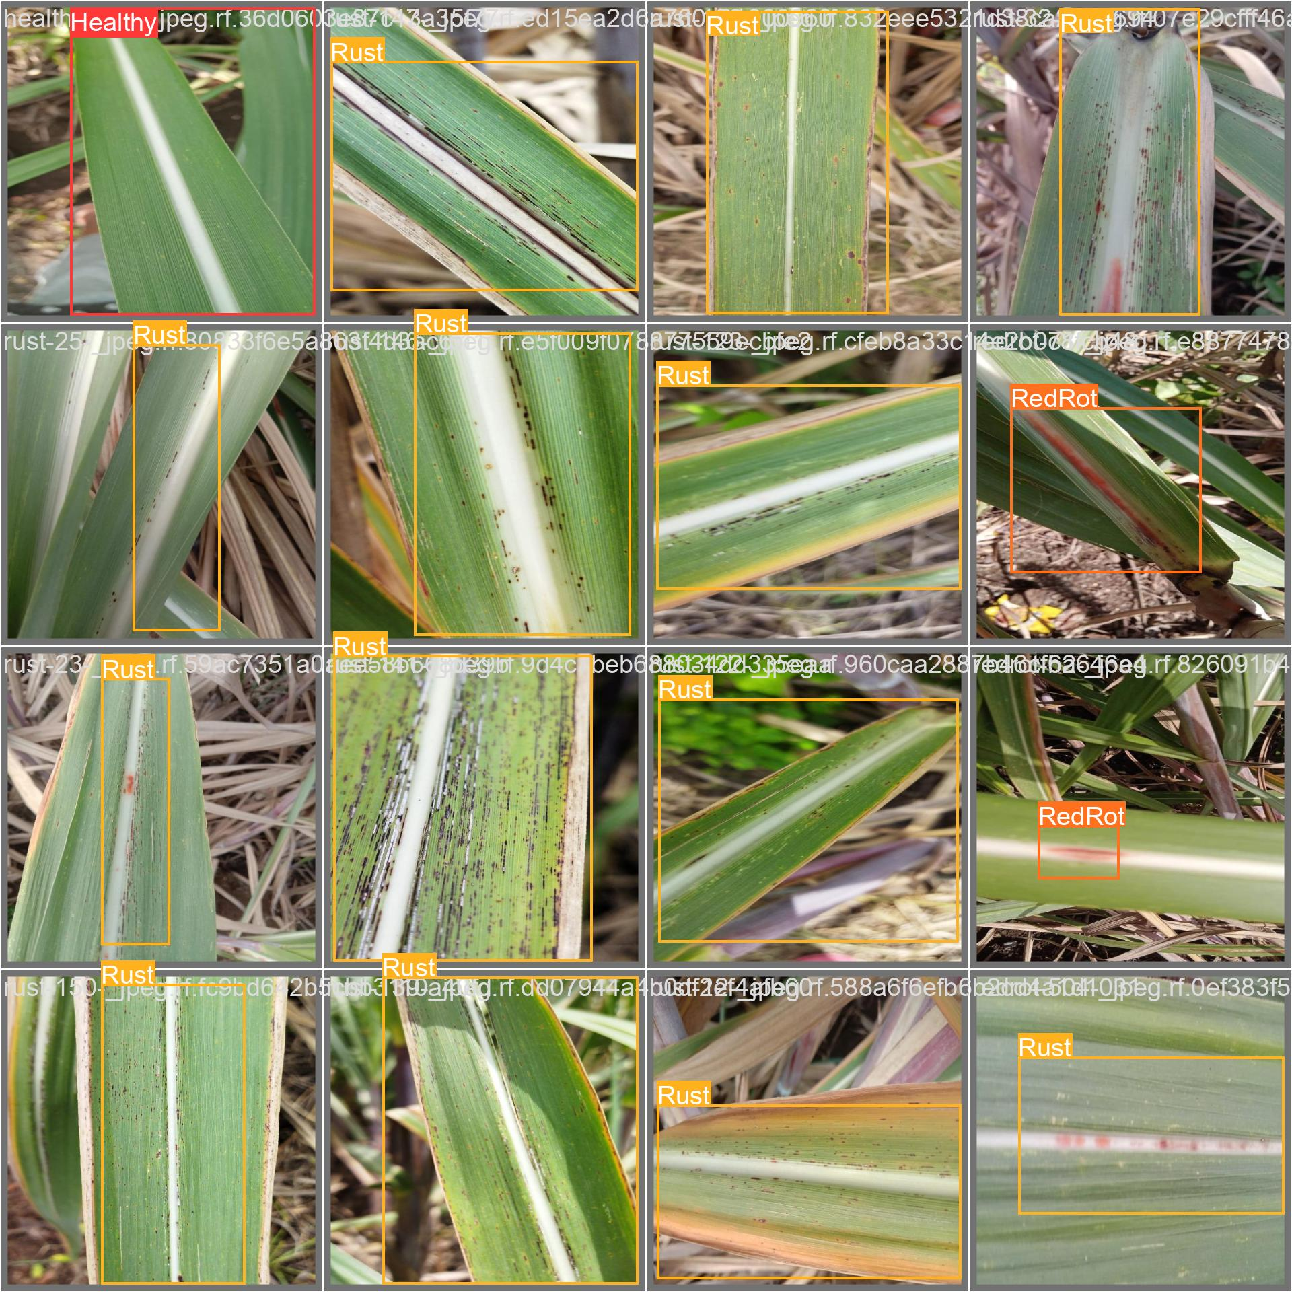
Results

Slide 34
Comparison of Architectures
Feature | CNN | RCNN | YOLO (Current Architecture)
Architecture Type | Basic deep learning architecture | Region-based architecture | Single-stage detector architecture
Speed | Fast for classification only (1-2s) | Slower (2-3s per image) | Real-time (0.02-0.05s per image)
Accuracy for Crop Diseases | Good for single-class classification (~85-90%) | High accuracy but slower (~90-95%) | Good balance (87% F1-score as shown)
Use Case Strength | • Basic disease classification • Whole image analysis • Growth stage detection | • Precise disease localization • Multiple disease detection • Detailed region analysis | • Real-time monitoring • Multiple disease detection • Field-scale implementation
Limitations | • No localization • Can't handle multiple diseases in same image • Fixed input size | • Computationally expensive • Not suitable for real-time • Complex training process | • Slightly lower precision than RCNN • May miss small lesions • Background confusion (as seen in matrix)
Performance on Current Task | Would only classify one disease per image | Would be more precise but slower | • 0.901 mAP@0.5 • Good multi-disease detection • Real-time capability
Best For | • Simple disease screening • Limited compute resources • Single disease focus | • Detailed disease studies • Research applications • High-precision needs | • Field implementation • Multi-disease monitoring • Real-time applications

Slide 35
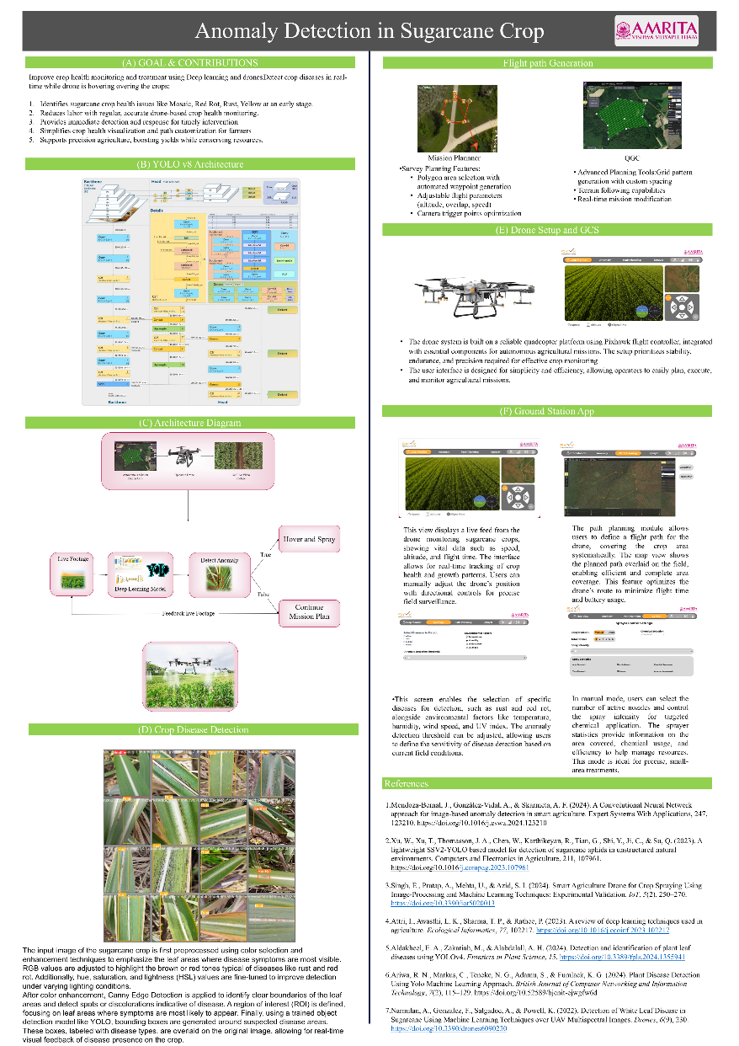
Poster

Slide 36
Explainable AI
Explainable AI (XAI) in crop disease detection is crucial for enabling real-time, transparent, and reliable decision-making in agriculture. By using explainable AI models, farmers and agricultural specialists can understand the reasoning behind disease predictions, helping them act on recommendations with confidence. Here’s an overview of how XAI could be implemented in crop disease detection for real-time applications:
AI Model Selection
Interpretable Models: Models like decision trees and rule-based systems are inherently interpretable but may not capture complex relationships as effectively as deep learning models.
Data Collection and Preprocessing
Image Processing in Real Time: Drones or mobile devices capture plant images, which are then preprocessed (noise reduction, normalization) before feeding into the AI model.
Integration with IoT Devices: For real-time use, IoT devices can transmit data directly to the cloud or edge devices for quick processing, reducing latency

Slide 37
References
Mendoza-Bernal, J., González-Vidal, A., & Skarmeta, A. F. (2024). A Convolutional Neural Network approach for image-based anomaly detection in smart agriculture. Expert Systems With Applications, 247, 123210. https://doi.org/10.1016/j.eswa.2024.123210
Xu, W., Xu, T., Thomasson, J. A., Chen, W., Karthikeyan, R., Tian, G., Shi, Y., Ji, C., & Su, Q. (2023). A lightweight SSV2-YOLO based model for detection of sugarcane aphids in unstructured natural environments. Computers and Electronics in Agriculture, 211, 107961. https://doi.org/10.1016/j.compag.2023.107961
Singh, E., Pratap, A., Mehta, U., & Azid, S. I. (2024). Smart Agriculture Drone for Crop Spraying Using Image-Processing and Machine Learning Techniques: Experimental Validation. IoT, 5(2), 250–270. https://doi.org/10.3390/iot5020013
Attri, I., Awasthi, L. K., Sharma, T. P., & Rathee, P. (2023). A review of deep learning techniques used in agriculture. Ecological Informatics, 77, 102217. https://doi.org/10.1016/j.ecoinf.2023.102217
Aldakheel, E. A., Zakariah, M., & Alabdalall, A. H. (2024). Detection and identification of plant leaf diseases using YOLOv4. Frontiers in Plant Science, 15. https://doi.org/10.3389/fpls.2024.1355941
Ariwa, R. N., Markus, C., Teneke, N. G., Adamu, S., & Fumlack, K. G. (2024). Plant Disease Detection Using Yolo Machine Learning Approach. British Journal of Computer Networking and Information Technology, 7(2), 115–129. https://doi.org/10.52589/bjcnit-ejwgfw6d
Narmilan, A., Gonzalez, F., Salgadoe, A., & Powell, K. (2022). Detection of White Leaf Disease in Sugarcane Using Machine Learning Techniques over UAV Multispectral Images. Drones, 6(9), 230. https://doi.org/10.3390/drones6090230

Slide 38
Thank You

